Slide 1
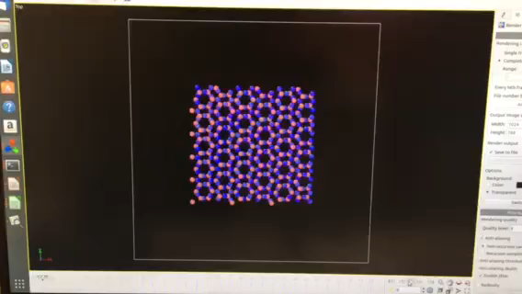


Silicon Nitride Molecular Dynamics
Chris Galus
Mentor: Mark Hawthorne

Slide 2
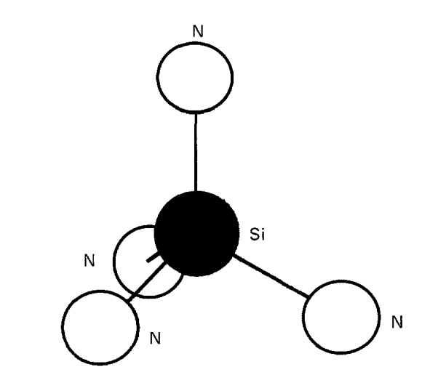
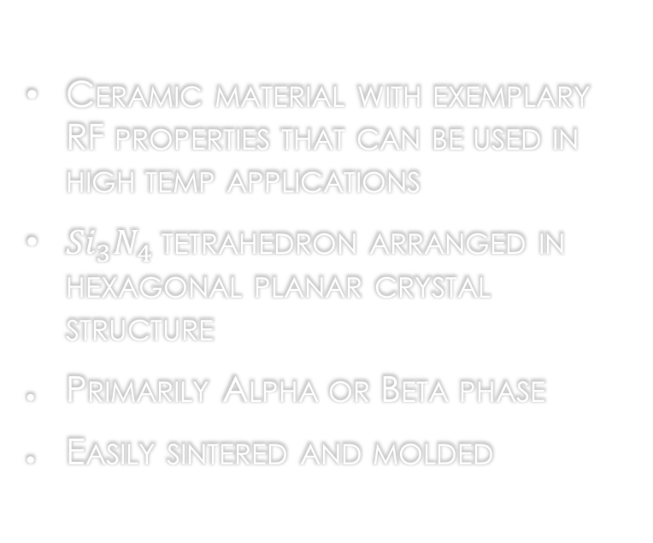
What is Silicon Nitride?
Ceramic material with exemplary RF properties that can be used in high temp applications
${Si}_{3}N_{4}$ tetrahedron arranged in hexagonal planar crystal structure
Primarily Alpha or Beta phase
Easily sintered and molded
Figure 1: Silicon Nitride tetrahedron

Slide 3

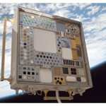

Current Importance of Silicon Nitride
Used in RIPS for high temperature
applications (>1650K)
Currently on the ISS being tested for long term exposure
Figure 2: 1400℃ Continuous use operation for hypersonic applications [1]
Figure 3: ${Si}_{3}N_{4}$ on board the ISS MISSE 7 experiment [1]

Slide 4
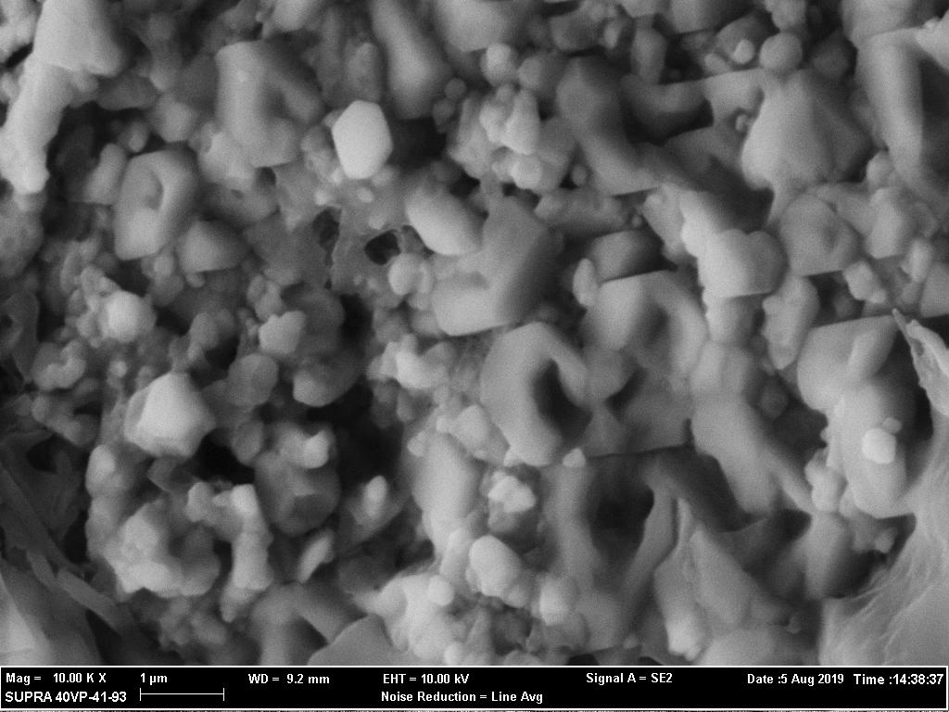
Physical Analysis
Physical samples created in the ATC lab were tested using XRD and viewed with a SEM
Alpha can be seen here, note the short (equiaxed) crystals
Figure 4: SEM image of Alpha Phase

Slide 5
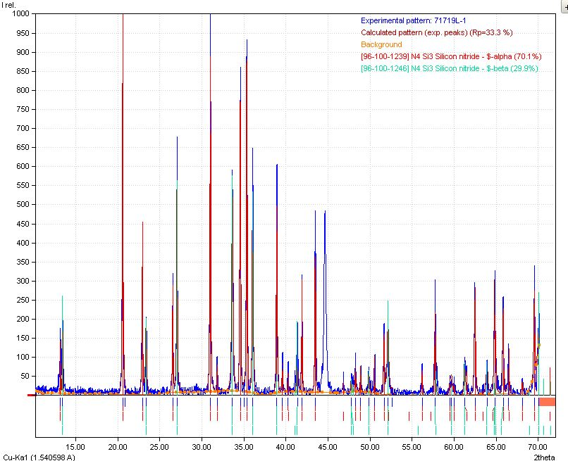
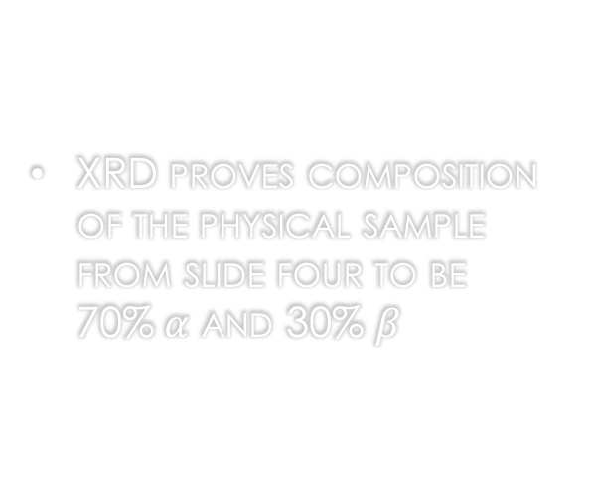
Physical Analysis
XRD proves composition of the physical sample from slide four to be 70%$α$ and 30% $β$
Figure 5: XRD plot of Alpha Phase
5

Slide 6
Physical Analysis
Beta can be seen here demonstrating the acicular growth
Figure 6: SEM image of Beta Phase

Slide 7
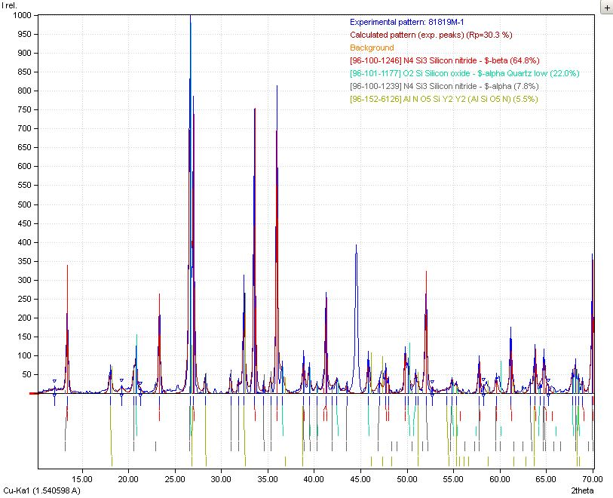
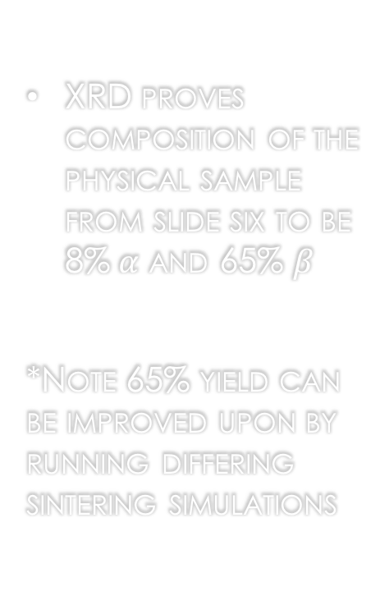
Physical Analysis
XRD proves composition of the physical sample from slide six to be 8%$α$ and 65% $β$
*Note 65% yield can be improved upon by running differing sintering simulations
Figure 7: XRD plot of Beta Phase
7

Slide 8
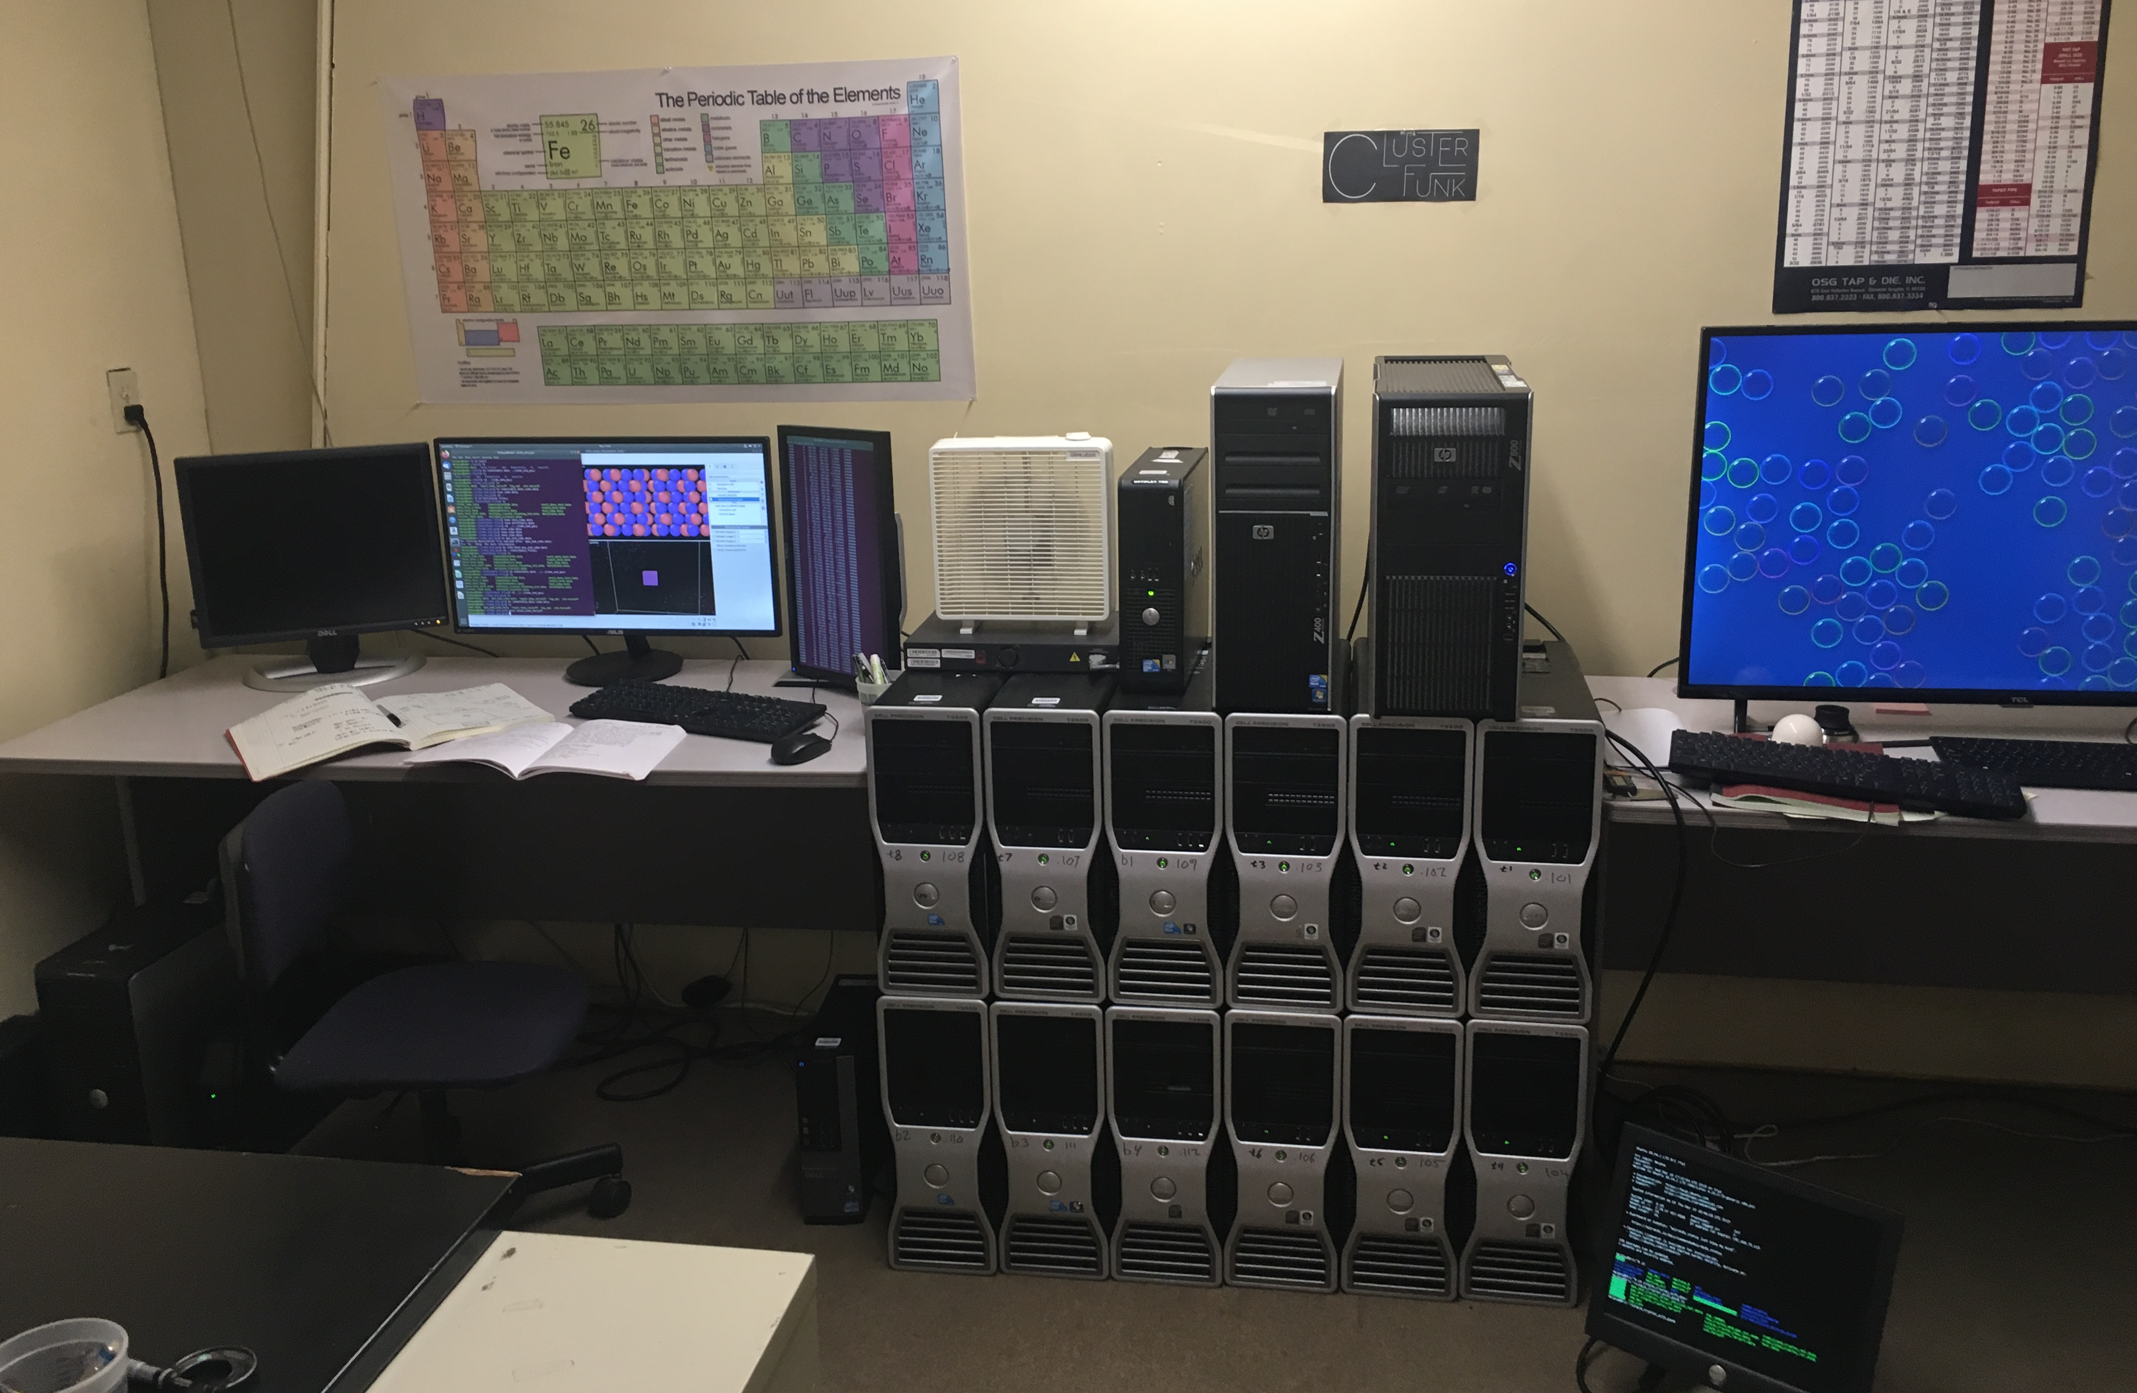
Setup Procedure
Molecular Dynamic studies require a large number of processors
Linux Ubuntu operating system
Connecting hardware
Installing message passing interface, lammps and visualization software [2,3]
Simulations need input (control) file, data (atom position) file, and potential (force field) files to run correctly
Figure 8: Linux Cluster

Slide 9
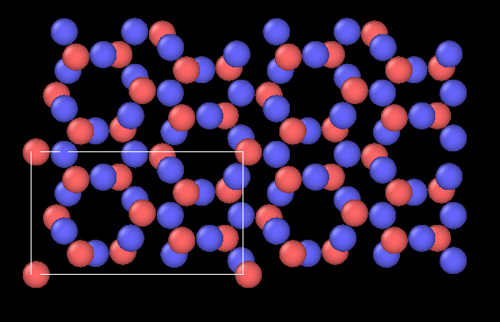
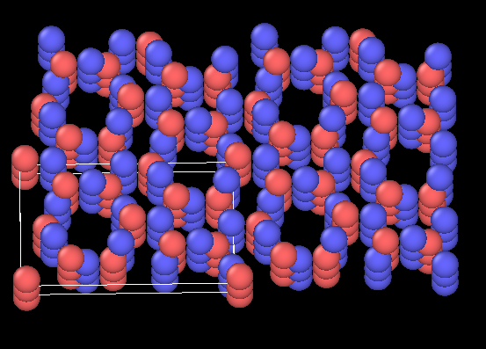
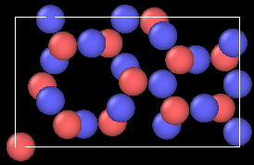
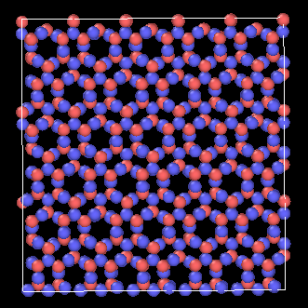
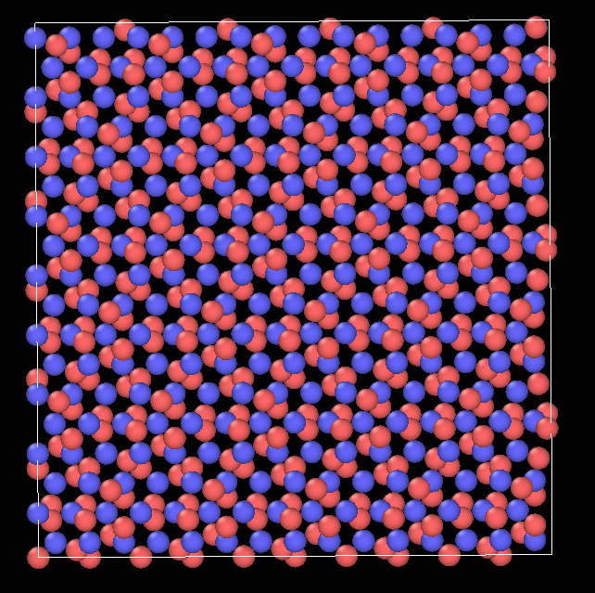
Data Collection
literature review of articles from Germany, china, and the U.S.
data obtained on lattice parameters gave the ability to create accurate unit cells
specifications from lammps gave the outline of how to run simulations
the literature gave the coefficients needed to create the Tersoff interatomic potential from scratch
ran tests then compared reaction to published results of temperature ramping, cte, and tensile tests
Figure 9: Periodicity of Beta Unit Cell
Figure 10: Top View of Beta
Figure 11: Top View of Alpha

Slide 10
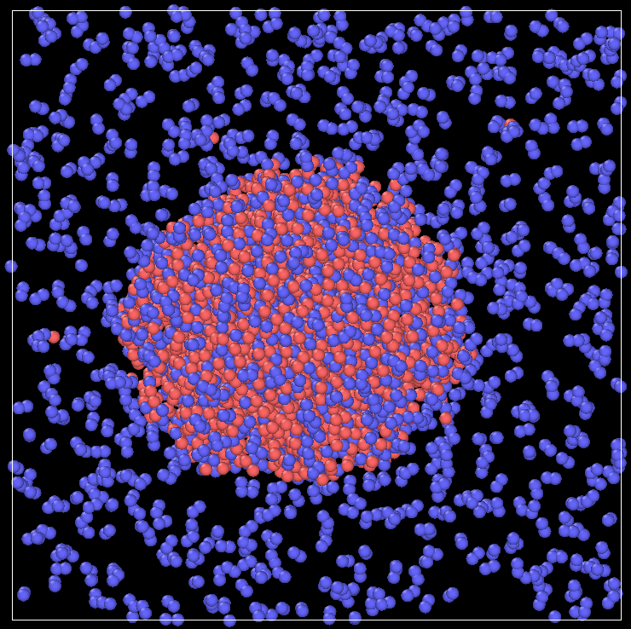
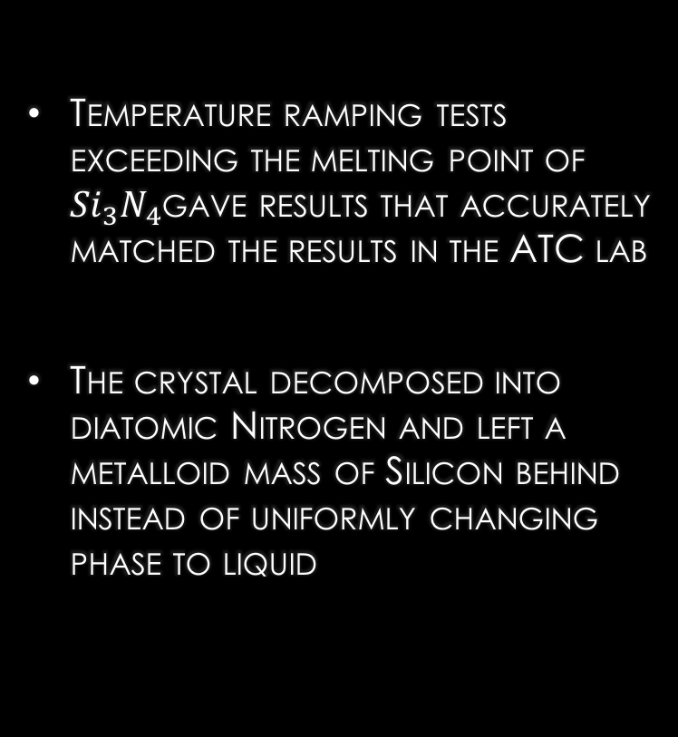
Attempted Simulations
(1/4)
Temperature ramping tests exceeding the melting point of ${Si}_{3}N_{4}$gave results that accurately matched the results in the ATC lab
The crystal decomposed into diatomic Nitrogen and left a metalloid mass of Silicon behind instead of uniformly changing phase to liquid
Figure 12: Melt/Decomposition
10

Slide 11
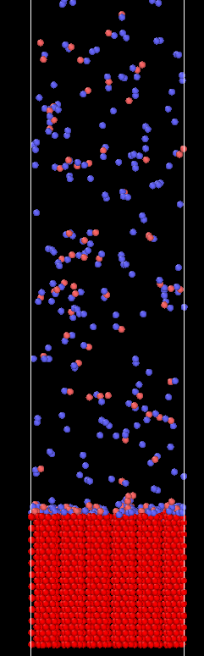
Attempted Simulations
(2/4)
Deposition growth along a column proved to be somewhat promising in growing a correct crystal
Due to the time scale of this to effectively take place, attempts at MD simulations as well as real application were futile
Figure 13: Deposition Growth
11

Slide 12
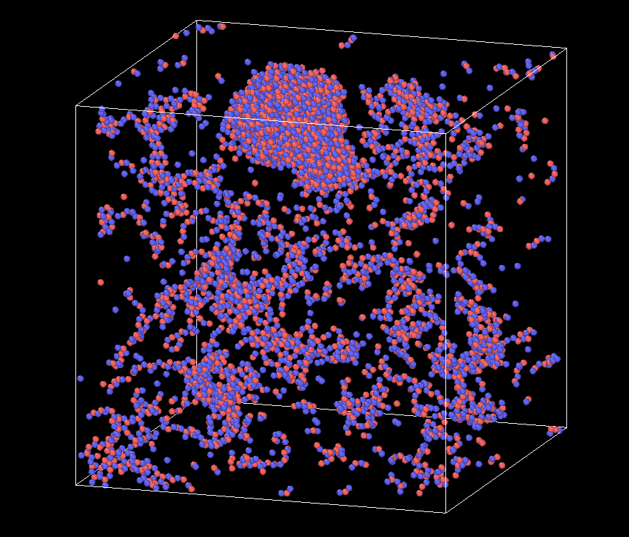
Attempted Simulations
(3/4)
Vapor condensation at temperatures lower than the melting point were able to create some good clumping
Due to the lack of gravity, and size of the simulation, these sites were fleeting and could not produce a usable liquid result
Figure 14: Vapor Condensation
12

Slide 13
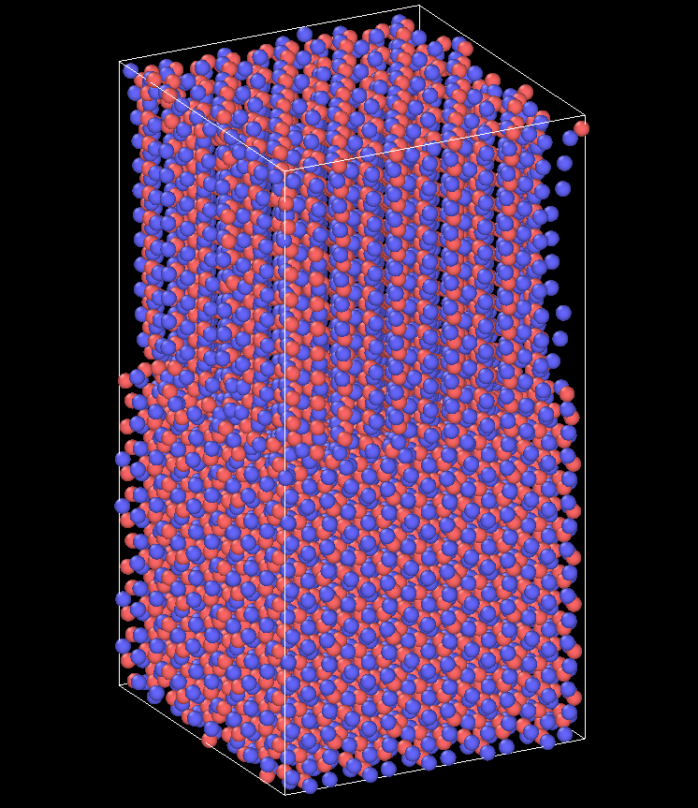
Attempted Simulations
(4/4)
Beta phase crystal is stacked directly on top of Alpha phase crystal
Temperature set to a value where diffusion of Silicon atoms could be very high while maintaining a solid state
Demonstrates imposing Beta sites into existing Alpha crystal for real application to increase thermal and mechanical shock resistance as well as dielectric properties
Results Pending – COVID-19
Figure 15: Phase Interface
13

Slide 14
Conclusions and Future Work
Due to COVID-19, progress on the final simulation tests were halted and resulted in only rudimentary results.
To finish out the project, gravity will be applied to all simulations to emulate the environment on Earth where the results will be proven. Alpha and Beta interface growth based on nucleation points will be studied and simulated further to confirm the potential growth reinforcement of interstitial Beta in large Alpha phase crystals.
Future:
  Continue using this technology to get a close to reality approximation of how extreme environments can affect the material performance
  Testing different manufacturing procedures to provide higher Beta phase yield and improved performance

Slide 15



Acknowledgements
NAU Space Grant Consortium
NASA
ATC Materials
Mark Hawthorne
Matt Rand
Paloma Davidson
Nadine Barlow
[4]
[5]
[6]

Slide 16
References
[1] ATC Materials. 2020. RF Materials Page. [online] Available at: <http://www.atcmaterials.com/rf- materials-page/> [Accessed 10 September 2019].
[2] Lammps.sandia.gov. 2020. LAMMPS Molecular Dynamics Simulator. [online] Available at: <https://lammps.sandia.gov/> [Accessed 30 September 2019].
[3] Ovito. A. Stukowski, Modelling Simul. Mater. Sci. Eng. 18, 015012 (2010).
Wang literature for tetrahedra
[4] National Space Grant Foundation. 2020. Northern AZ AISES & Hispanic Engineers - National Space Grant Foundation. [online] Available at: <https://spacegrant.org/sg_programs/northern-az_aises-hispanic-engineers/>
[5] Nasa 2020. NASA Insignia. [online] Available at: <https://en.wikipedia.org/wiki/NASA_insignia#/media/File:NASA_logo.svg>
[6] ATC Materials Inc. 2020. [online] Available at: <https://www.linkedin.com/company/atcmaterials/about/>

Slide 17
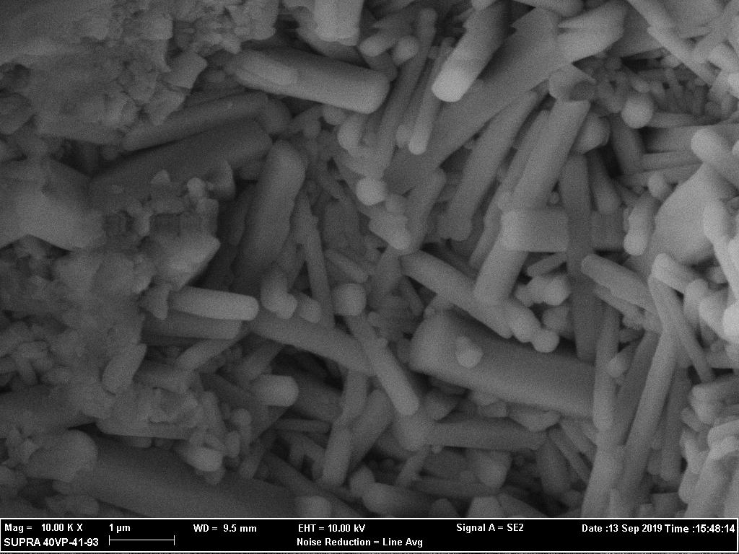
Questions?

